Slide 1



Implementing CI/CD pipeline for website monitoring
Under the guidance of
Dr.R.V. Sudhakar

Slide 2






Meet the team
Ruchith
Srija
Swaroop
Developer
Developer
Developer

Slide 3




Agenda
What motivated the team
Introduction
Existing System
Proposed System
Implementation
Output
Conclusion

Slide 4

What motivated the team to take up the project?
The team was motivated to undertake the CI/CD pipeline project due to current industry trends emphasizing automation, efficiency, and continuous delivery. As modern development practices shift towards rapid, reliable, and scalable deployments, leveraging tools like Jenkins, SonarQube, Docker, Kubernetes, Prometheus, and Grafana becomes essential. These technologies align with trends in DevOps and cloud-native development, where streamlined workflows, automated testing, and real-time monitoring are crucial for maintaining high-quality software and adapting quickly to market demands.

Slide 5

Introduction
Abstract
The CI/CD pipeline automates application deployment through an integrated suite of tools. Code commits trigger Jenkins, which uses SonarQube for static code analysis and Nexus for dependency management. Jenkins then builds and packages the application in Docker containers, which are stored in a Docker registry. Kubernetes handles the deployment and scaling of these containers, while Prometheus collects performance metrics and Grafana provides real-time visualization of these metrics. This streamlined process enhances code quality, ensures reliable builds, and offers comprehensive monitoring for efficient application delivery.

Slide 6


Traditional software development typically follows a structured, sequential process, such as the Waterfall model, where each phase—requirements gathering, design, implementation, testing, and deployment—is completed in a linear order.
Development and operations teams work in silos, with little collaboration or automation between them. This approach often results in longer development cycles, slower release times, and a higher risk of errors due to manual testing and deployment.
While suitable for projects with well-defined requirements, it lacks the flexibility, speed, and continuous feedback loops that DevOps practices provide, making it less adaptable to changing needs and complex, scalable environments.
Traditional Model

Slide 7
Using CI/CD (Continuous Integration/Continuous Deployment) pipelines in software development automates the process of integrating code changes, testing them, and deploying them to production.
This approach enables developers to continuously merge code into a shared repository, where automated tests validate the changes, ensuring that issues are caught early.
Once the code passes these tests, it is automatically deployed to production or staging environments, reducing manual intervention and the risk of human error.
CI/CD pipelines foster a faster, more reliable, and consistent release process, enabling teams to deliver new features, fixes, and updates more frequently and with greater confidence.
Proposed
System

Slide 8
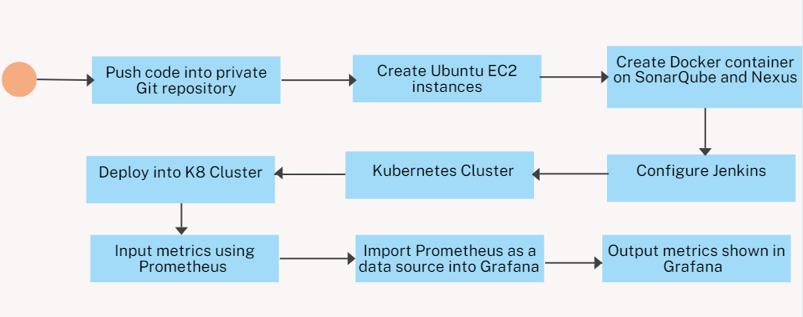
The following shows the flow of the project
Implementation
of the System

Slide 9
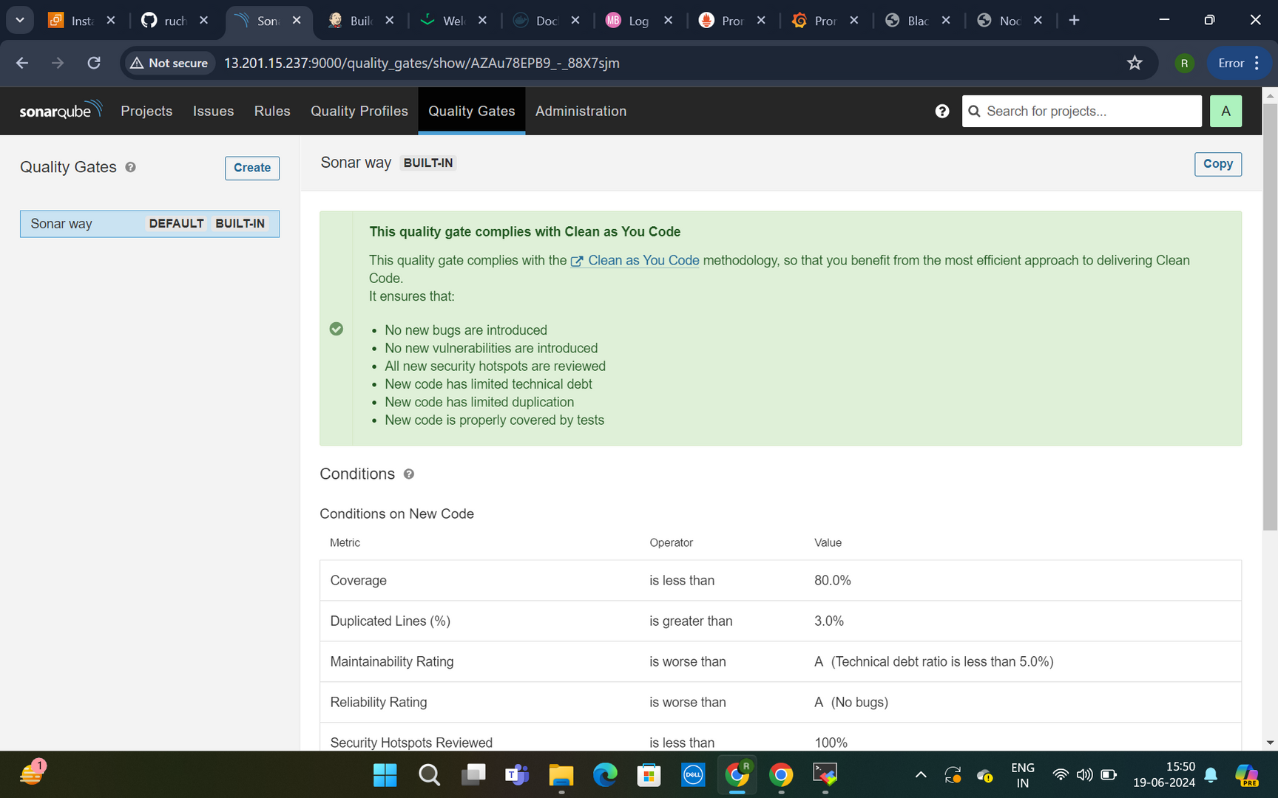
SonarQube
Metrics

Slide 10
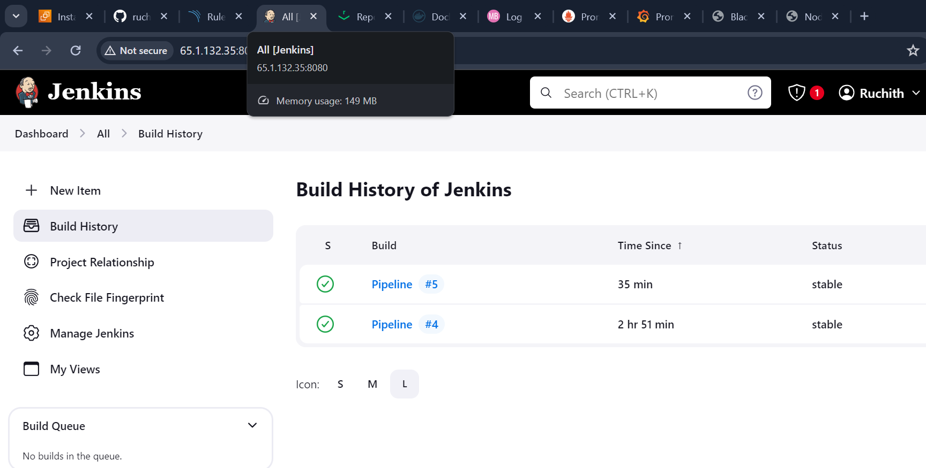
Pipeline Build

Slide 11
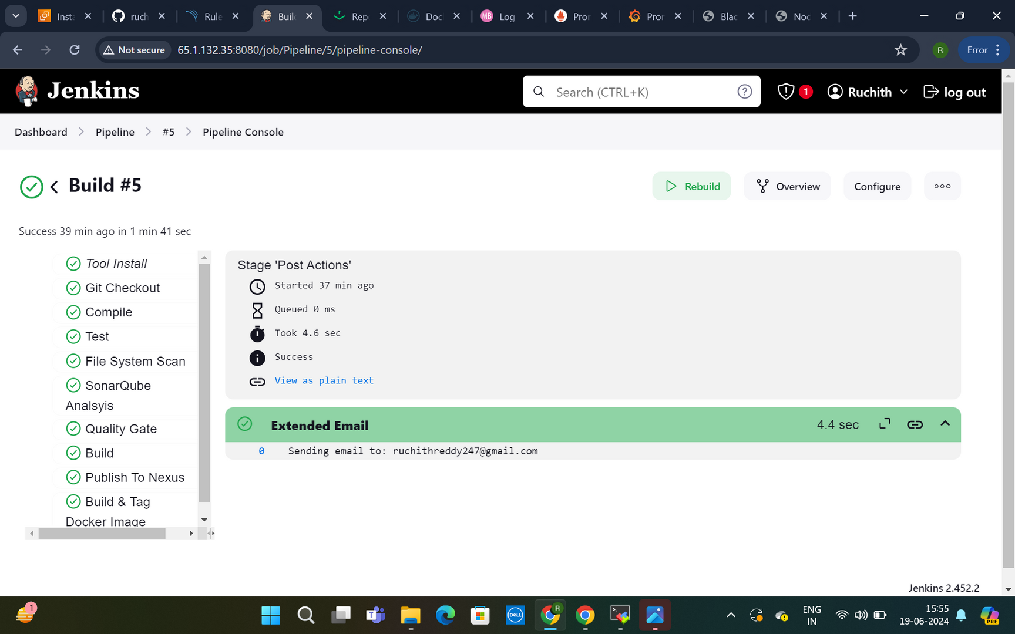

Slide 12
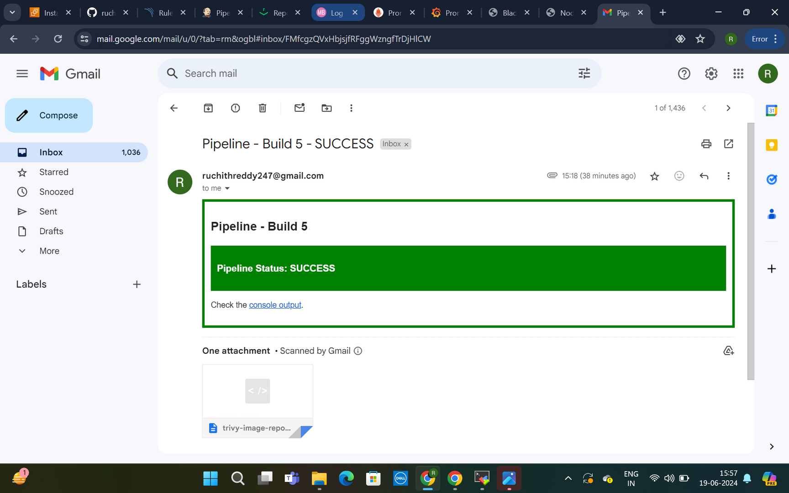
Mail Alert

Slide 13
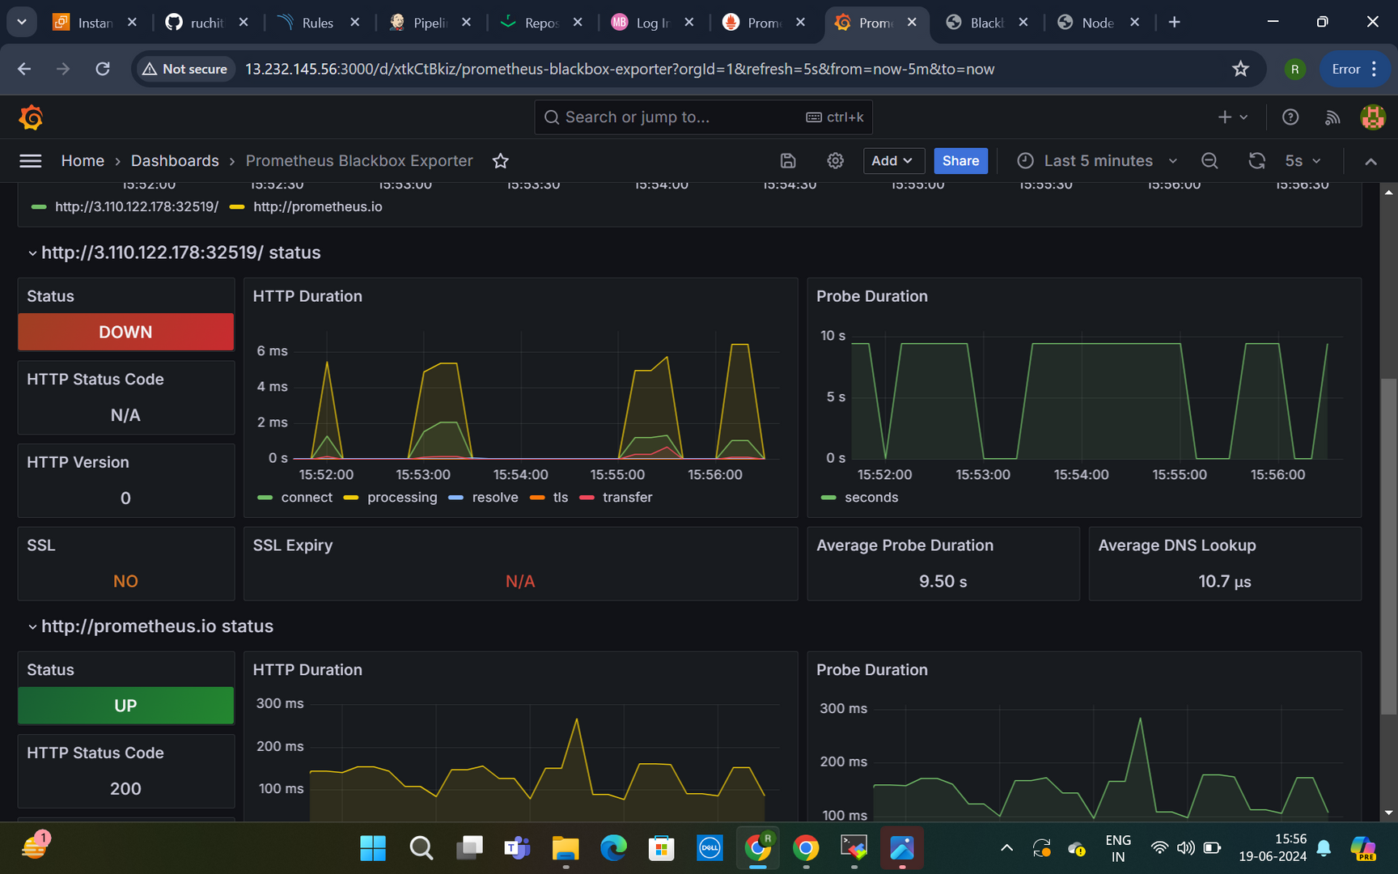
Grafana
Dashboard

Slide 14
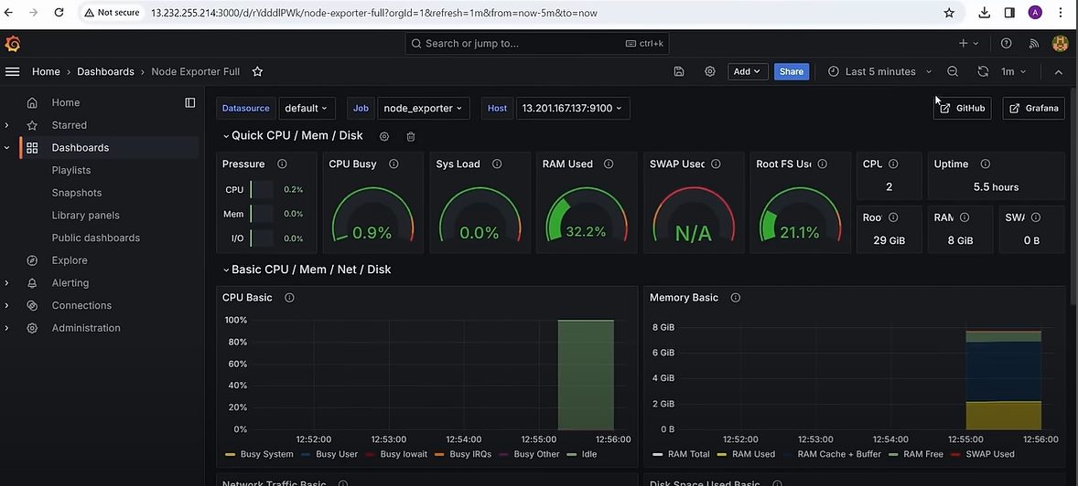

Slide 15



CONCLUSIONS
+Version Control and Repository Setup
+Automated Testing and Build Automation
+CI/CD Pipeline Configuration and Deployment Automation
+Monitoring and Feedback
+Continuous Improvement
Investing in CI/CD not only improves the development process but also enhances collaboration among development, testing, and operations teams. As the landscape of web development continues to evolve, embracing CI/CD is a crucial step toward staying competitive and delivering web apps that meet the demands of today’s fast-paced digital world.

